Slide 1

Resilience Class Structure
Intro to Resilience bootcamp or Class Topic
Instructor Intro & Student Intros
Lecture & Labs
Breaks throughout & a 1 Hour long Lunch
Day Recap
Kahootz & Quiz
Capstone Project at the end of the Bootcamp
Notes:
Today’s goal is to build a shared understanding of resilience and recovery.
You will learn why both matter, how they work together, and how they impact operations.
You will connect these ideas to real events and practical frameworks.

Slide 2

Who am I? Andry Rakotomalala, MBA, Net+, Sec+
10+ years in cybersecurity, GRC, and risk programs for Intuit, AEG, Agoda, Accenture, Thumbtack, and Amazon UK.
Delivered SOC 2 and ISO 27001 audit readiness with a 100 percent pass rate across four quarterly audits.
Led BIAs across multiple business units to strengthen recovery priorities and operational resilience.
Directed enterprise risk assessments that reduced exposure in high-impact areas.
Implemented 100+ security controls aligned with NIST CSF, MITRE ATT&CK, OWASP, COBIT, and ISO.
Led Red and Blue Team readiness work to improve threat detection and response accuracy.
Ran company-wide security awareness and phishing programs to reduce human-driven risk.
Notes:
Over a decade of experience in cybersecurity, governance, risk, and compliance across global organizations, including Intuit, AEG Worldwide, Agoda, Accenture, Thumbtack, and Amazon UK.
Led SOC 2, ISO 27001, CMMC, HIPAA, CCPA, and GDPR compliance initiatives with proven results, including a 100 percent pass rate across four consecutive quarterly internal audits.
Directed business impact analyses and resilience planning across multiple business units, strengthening recovery prioritization and operational readiness Andry R Resume (Instructor) .
Managed large-scale risk assessment programs, identifying and reducing high-impact exposure areas and contributing to measurable reductions in risk.
Implemented and operationalized over one hundred security controls aligned with major frameworks such as NIST CSF, MITRE ATT&CK, OWASP, COBIT, and ISO standards.
Delivered Red Team and Blue Team readiness assessments, improving threat detection and informing resilience strategies across SOC environments.
Supported enterprise-wide security awareness and human-risk reduction through structured campaigns, phishing programs, stakeholder alignment, and cross-functional communication.

Slide 3
What is your current role?
What is your exposure to resilience?
What AI tools do you currently use?
Notes:
https://www.ncsc.gov.uk/static-assets/documents/PwnedPasswordsTop100k.txt

Slide 4

Resilience vs. Recovery: Concepts and Real-World Application
Learn the strategic differences between proactive resilience and reactive recovery
Explore real-world applications in technology environments
Understand why resilience has evolved into a board-level priority
Apply frameworks for building comprehensive continuity programs
Notes:
Resilience is about planning ahead so disruptions don’t hit as hard. Recovery is what you do after damage happens.
Boards focus on resilience now because disruptions are more common and more expensive.
Strong resilience makes recovery faster and cleaner.
Example: Think of a home with storm-ready windows. Resilience is reinforcing the windows before hurricane season. Recovery is fixing the broken glass after the storm.

Slide 5
Class Agenda
Class Objectives
Introduction to resilience and recovery
Define resilience and recovery in an enterprise context
Differences and similarities
Explain their relationship within continuity planning
Core principles and frameworks
Real-world examples
Identify key business and technical drivers
Building a balanced strategy
Analyze case studies to apply these concepts effectively
Notes:
Today’s goal is to build a shared understanding of resilience and recovery.
You will learn why both matter, how they work together, and how they impact operations.
You will connect these ideas to real events and practical frameworks.

Slide 6

Defining Resilience
Resilience represents an organization's ability to anticipate, prepare for, respond to, and adapt to incremental change and sudden disruptions in order to survive and prosper. Unlike traditional reactive approaches, resilience is fundamentally proactive—it's about building strength before crisis strikes.
Capacity to absorb shocks while maintaining critical functions
Extends beyond technology to encompass people, processes, and partnerships
Organizations emerge stronger from challenges through continuous learning
Builds defensive posture through preparation and adaptation
Notes:
Resilience means preparing for trouble before it happens.
It covers people, processes, and technology, not just systems.
A resilient organization learns from events and adapts quickly.
Example: A gym that keeps trainers certified across multiple programs stays open even if one trainer quits suddenly. That adaptability is resilience.

Slide 7

Defining Recovery
Recovery involves the systematic restoration of technology infrastructure, business processes, and operational capabilities following an incident or disaster. Recovery is reactive by nature, activated after disruption occurs with defined time-bound objectives.
Process of restoring systems to normal or improved functioning
Systematic approach with documented procedures and playbooks
Driven by specific objectives like RTO and RPO requirements
Focuses on minimizing impact duration after incidents occur
Ensures methodical restoration of full operational capacity
Timeline-driven with clear milestones and success criteria
Notes:
Recovery starts after disruption hits.
It uses predefined steps with clear milestones.
The goal is restoring operations fast and safely.
Example: If a restaurant loses power, recovery is using a generator, checking food temperatures, and reopening based on your emergency checklist.

Slide 8

Why Both Matter
Both resilience and recovery are essential components of a comprehensive business continuity strategy. Resilience minimizes the depth and duration of disruptions, while recovery ensures systematic restoration when disruptions occur. Organizations need both to protect their operations effectively.
Resilience reduces the severity and scope of initial impact
Recovery provides structured path back to normal operations
Together they create layered defense against business disruption
Complementary approaches that address different phases of incidents
Both contribute to organizational strength and sustainability
Notes:
Resilience reduces how painful a disruption is.
Recovery brings services back to normal.
They complement each other to keep the business stable before, during, and after disruption.
Example: A hospital with backup generators (resilience) still needs procedures to bring systems online after an outage (recovery).

Slide 9
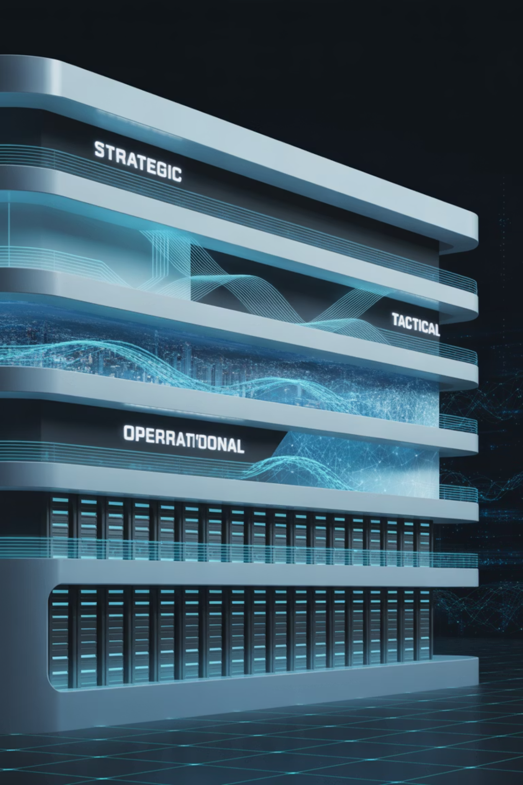
Strategic vs Tactical vs Operational Levels
Resilience and recovery operate across three organizational levels, each requiring different approaches and capabilities. Understanding these levels ensures appropriate investment and alignment across the enterprise.
Strategic Level: Board governance, enterprise risk management, investment decisions
Tactical Level: Program management, resource allocation, policy development
Operational Level: Day-to-day monitoring, incident response, system maintenance
Each level requires different skills, tools, and success metrics
Coordination between levels essential for comprehensive coverage
Resilience and recovery strategies must align at all three levels
Notes:
Resilience exists at leadership level, planning level, and day-to-day level.
Each level has different responsibilities but must be aligned.
Misalignment creates gaps during crisis.
Example: At an airport, leadership decides on safety investment, operations allocate staff and resources, and front-line crews manage emergencies in real time.

Slide 10





The Operational Resilience Lifecycle
The resilience lifecycle provides a systematic approach to building and maintaining organizational strength. This continuous cycle ensures organizations don't just survive disruptions—they evolve and strengthen with each challenge.
Plan
Define scope
Strategize
Impact Assessment, Strategy
Validate
Implement and Test
Improve
Monitoring & Review
Notes:
Resilience is not a one-time plan but an ongoing cycle.
Organizations plan, prepare, test, and improve continuously.
Each phase strengthens the next.
Example: Think of maintaining your car: you plan services, check fluids, repair issues, and learn from past breakdowns to avoid new ones

Slide 11

The Role of Business Impact Analysis (BIA)
Business Impact Analysis serves as the foundation for both resilience and recovery planning. BIA identifies critical processes, supporting systems, and dependencies while establishing recovery priorities based on business value and risk exposure.
Identifies critical business processes and their interdependencies
Quantifies potential impacts from various disruption scenarios
Establishes recovery priorities based on business criticality
Defines acceptable downtime limits and data loss tolerances
Guides resource allocation for resilience and recovery investments
Must involve both IT and business stakeholders for accuracy
Notes:
BIA helps you identify your most important processes.
It tells you what must be restored first and what can wait.
It aligns resources with business impact.
Example: If a school’s network fails, restoring student attendance systems comes before classroom slide projectors.

Slide 12
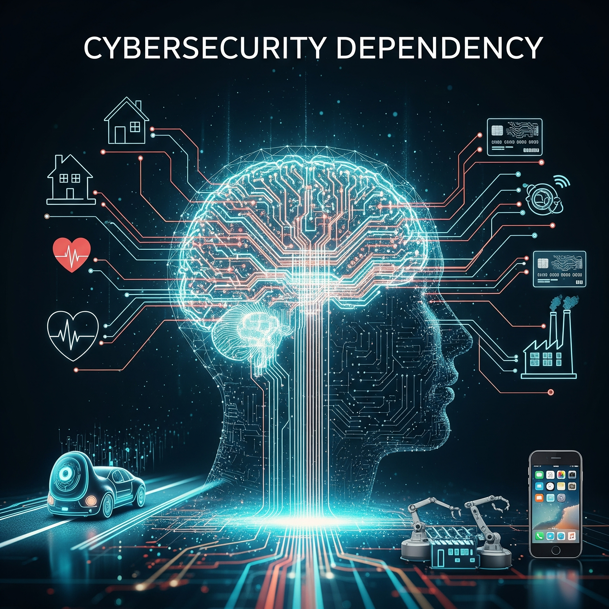
Dependencies and Enablers
Understanding organizational dependencies is crucial for effective resilience and recovery planning. Dependencies create vulnerabilities while enablers provide the capabilities needed to maintain and restore operations.
System Dependencies: Technology interdependencies and data flow requirements
People Dependencies: Key personnel, specialized skills, and knowledge assets
Process Dependencies: Sequential workflows and approval chains
Vendor Dependencies: Third-party services and supply chain relationships
Infrastructure Enablers: Facilities, networks, and utility services
Map dependencies to identify single points of failure and cascade risks
Notes:
Every business relies on technology, people, processes, and vendors.
Dependencies can become failure points.
Mapping them prevents blind spots.
Example: If your coffee shop relies on one supplier and they fail, your operations stop entirely. That’s a dependency risk.

Slide 13

Recovery Time Objective (RTO) vs Recovery Point Objective (RPO)
RTO and RPO are fundamental metrics that define recovery requirements and guide resource allocation decisions. These objectives establish clear targets for restoration activities and help organizations balance cost with acceptable risk levels.
RTO
RPO
Recovery Time Objective
Recovery Point Objective
The maximum acceptable time period that systems or processes can remain unavailable after a disruption before causing unacceptable consequences to the business
The maximum acceptable age of data that can be lost during a disruption, defining how frequently backups must occur to meet business requirements
RTO drives investment in recovery infrastructure and automation
RPO determines backup frequency and replication requirements
Both metrics should align with business impact analysis findings
More aggressive objectives require higher investment in capabilities
Notes:
RTO defines how fast you must restore service.
RPO defines how much data loss is acceptable.
Both guide investment decisions.
Example: A bank may accept losing 1 minute of transactions (tight RPO) but needs service back within an hour (strict RTO).

Slide 14








Continuity Planning in Action
Business continuity management serves as the umbrella framework that encompasses both resilience and recovery. Think of continuity as the strategic architecture, resilience as the defensive foundation, and recovery as the restoration mechanism.
Resilience
Continuity
Builds organizational strength to resist and absorb disruptions
Maintains critical functions during and after incidents
Improvement
Recovery
Learns from events to strengthen future response
Restores full operational capacity systematically
Notes:
Continuity ties resilience and recovery together.
Resilience keeps systems running.
Recovery restores full capacity.
Improvement closes the loop.
Example: An airline uses resilience to reroute flights during storms and recovery to rebuild schedules afterward.

Slide 15
Key Differences Between Resilience and Recovery
Understanding the fundamental differences between resilience and recovery helps organizations make appropriate investments and design comprehensive continuity capabilities.
Proactive Resilience
Reactive Recovery
Prevention First
Post-Incident Focus
Build strong defenses; monitor continuously.
Activate after disruption, follow procedures.
Continuous Capability
Systematic Restoration
Maintain operations during disruptions.
Restore systems to baseline state.
Adaptive Response
Time-Bound Objectives
Adjust rapidly to evolving threats.
Minimize impact with RTO/RPO.
Notes:
Resilience = proactive.
Recovery = reactive.
Resilience adapts; recovery restores.
Both are necessary and measured differently.
Example: A fitness center strengthens its building to withstand earthquakes (resilience), then has emergency repair procedures after a quake (recovery).

Slide 16
Why Both Matter
Both resilience and recovery are essential components of a comprehensive business continuity strategy. Resilience minimizes the depth and duration of disruptions, while recovery ensures systematic restoration when disruptions occur. Organizations need both to protect their operations effectively.
Resilience reduces the severity and scope of initial impact
Recovery provides structured path back to normal operations
Together they create layered defense against business disruption
Complementary approaches that address different phases of incidents
Both contribute to organizational strength and sustainability
Notes:
Reinforces earlier concepts.
Highlights why a balanced approach avoids bigger losses.
Both functions support long-term sustainability.
Example: A hospital prepares for electrical surges (resilience) and activates backup power (recovery) when surges occur.

Slide 17

Organizational Mindset and Preparedness
Boards now see organizational resilience as essential for protecting value and ensuring long-term viability. The shift from reactive to proactive thinking has become a competitive necessity in today's threat environment.
Cyber Threats
High ransomware costs
Increased board liability
Operational Complexity
Complex interdependencies
Cascading failure risk
Notes:
Leadership now treats resilience as essential.
Increased cyber threats require investment.
Complex systems create cascading risks.
Example: Streaming platforms scale globally. If one region fails, traffic reroutes instantly, but leadership must plan for capacity and cyber risks.

Slide 18

Real-World Example: Travel Company BIA-Driven Recovery Prioritization
This example demonstrates how thorough business impact analysis enables effective prioritization during major disruptions, ensuring critical customer-facing capabilities receive immediate attention while supporting systems follow in logical sequence.
Challenge: Regional data center outage affecting booking and reservation systems
Resilience Response: Geographic redundancy enabled automatic failover to secondary site
Recovery Strategy: BIA-driven priorities focused on customer booking capabilities first
Outcome: Customer-facing applications experienced zero downtime during 4-hour outage
Lesson Learned: Investment in resilient architecture paid immediate dividends
Improvement: Enhanced monitoring and failback procedures for future incidents
Notes:
Prioritizing customer-facing systems maintained service during outage.
Redundancy made failover seamless.
Learning improved future procedures.
Example: If a hotel’s booking system shifts to its backup location without customers noticing, resilience is working

Slide 19
Real-World Example: Consulting Company’s SOC2 and ISO27001 Audit Resilience
This case shows how compliance-driven resilience investments create operational benefits beyond regulatory requirements, enabling organizations to maintain business operations even during intensive audit periods.
Challenge: Simultaneous SOC2 and ISO27001 audits during peak business period
Resilience Response: Documented processes and automated controls reduced audit burden
Recovery Planning: Incident response procedures tested and validated during audit
Outcome: Successfully maintained operations while passing both audit requirements
Lesson Learned: Compliance frameworks strengthen operational resilience capabilities
Improvement: Integrated audit preparation into continuous improvement processes
Notes:
Strong documentation supports audits and operations.
Validated recovery procedures strengthened confidence.
Audits reinforced resilience maturity.
Example: A company that keeps clean financial records handles tax audits with minimal disruption

Slide 20
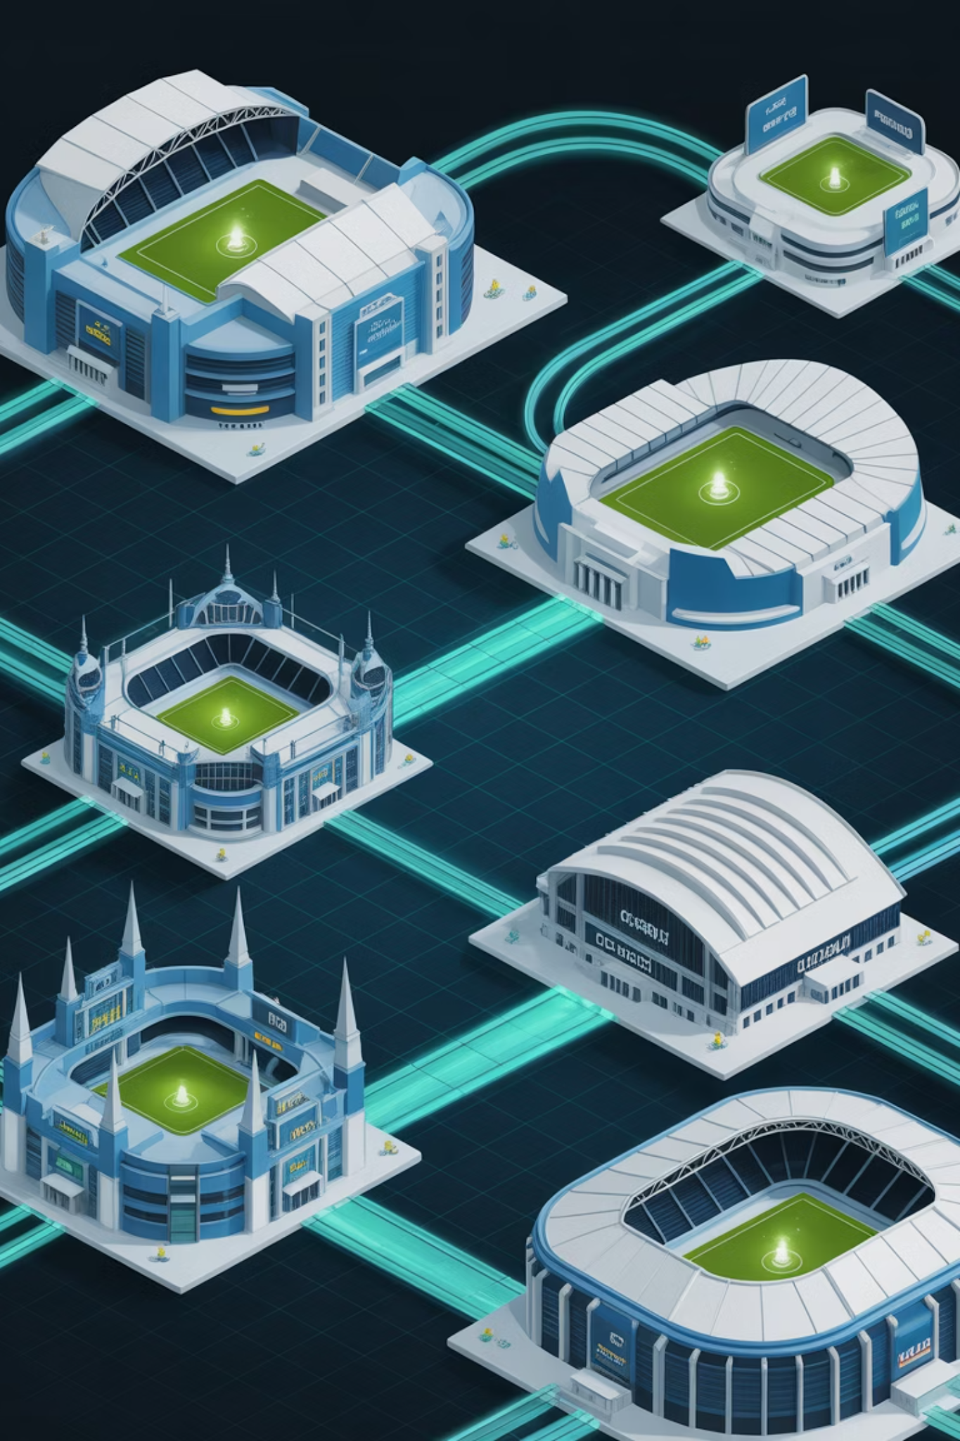
Real-World Example: Multi-Site Incident Response Alignment
This example illustrates how coordinated incident response across multiple sites requires integrated resilience and recovery capabilities, with clear communication protocols and unified command structures.
Challenge: Coordinating incident response across multiple venue locations simultaneously
Resilience Response: Standardized communication protocols and unified command structure
Recovery Strategy: Site-specific recovery procedures aligned with corporate standards
Outcome: Successfully managed incidents at three venues with no customer impact
Lesson Learned: Standardization enables scalable incident response capabilities
Improvement: Enhanced cross-site coordination and resource sharing protocols
Notes:
Coordinated communication prevented service disruption.
Each site followed clear instructions aligned with HQ.
Standardization made multi-site response smooth.
Example: Multiple retail stores facing a credit card system outage follow one unified instruction set from HQ, avoiding customer panic.

Slide 21




Integrating Cyber, Data, and People Resilience
Comprehensive resilience requires coordinated strength across four interdependent organizational layers. Weakness in any single layer can compromise the entire resilience posture, making balanced investment critical for protection.
Technology Resilience
People Resilience
Redundant infrastructure and failover systems
Cross-training and succession planning
Cybersecurity controls and monitoring
Crisis communication protocols
Automated recovery capabilities
Remote work capabilities
Process Resilience
Vendor Resilience
Documented procedures and playbooks
Third-party risk assessments
Alternate workflow capabilities
Service level agreements with resilience clauses
Continuous improvement mechanisms
Joint business continuity planning
Notes:
Resilience must cover technology, people, processes, and vendors.
A gap in any area exposes the entire system.
Balanced investment avoids imbalance.
Example: If a clinic has strong IT systems but only one person knows how to operate them, the person becomes a vulnerability.

Slide 22

Testing and Continuous Improvement
Effective continuity programs require regular testing to validate capabilities and identify improvement opportunities. Testing should encompass both resilience mechanisms and recovery procedures through integrated exercises.
Tabletop Exercises: Test decision-making and communication protocols
Technical Simulations: Validate technology recovery capabilities
Full-Scale Drills: Exercise complete end-to-end response
After-Action Reviews: Capture lessons learned and improvement opportunities
Plan Updates: Incorporate lessons into policies and procedures
Training Programs: Maintain staff readiness and competency
Notes:
Testing reveals weaknesses before real incidents.
Exercises build readiness and confidence.
Improvement comes from real test lessons.
Example: Fire drills help people evacuate calmly during real fires because they practiced it first.

Slide 23

Communicating During Disruption
Effective crisis communication is essential for maintaining stakeholder confidence and coordinating response efforts. Communication strategies must address both internal coordination and external transparency requirements.
Internal Communication: Clear chains of command and decision authority
Customer Communication: Transparent updates and realistic timelines
Regulatory Communication: Timely notifications as required by compliance
Media Communication: Consistent messaging and designated spokespeople
Vendor Communication: Coordination with third-party service providers
Documentation: Record decisions and actions for post-incident review
Notes:
Communication determines how people respond.
Internal clarity reduces confusion.
External updates maintain trust.
Example: When an airline delays flights, clear announcements reduce customer anger and chaos.

Slide 24

Summary and Key Takeaways
Resilience and recovery represent complementary capabilities that together create comprehensive business continuity protection. Organizations that master both achieve superior outcomes during disruptions.
Resilience is proactive and continuous - builds strength before, during, and after incidents
Recovery is reactive and time-bound - provides systematic restoration following disruptions
Both are essential - resilience reduces impact while recovery ensures restoration
Integration is critical - unified planning across technology, people, processes, and vendors
Testing validates capabilities - regular exercises identify gaps and improvement opportunities
Board-level commitment is necessary - resilience requires strategic investment and governance
Building resilience is about preparation, awareness, and continuous improvement.
Notes:
Resilience prepares. Recovery restores.
Integrated planning ensures survival.
Testing and governance keep programs mature.
Example: A school district that plans ahead for flooding and practices evacuations recovers faster when storms hit.

Slide 25
BREAK TIME
Be back in 15 mins.
Notes:
https://www.ncsc.gov.uk/static-assets/documents/PwnedPasswordsTop100k.txt

Slide 26

Strategic, Tactical & Operational Goals of Resilience and Recovery
Organizational resilience succeeds when strategic vision, tactical planning, and operational execution work in harmony. These three interconnected levels create a comprehensive framework that transforms resilience from a reactive capability into a proactive organizational strength, ensuring business continuity across all scenarios.
Master the distinct roles of strategic, tactical, and operational resilience goals
Understand how leadership vision translates to daily operational readiness
Explore real-world applications across all three organizational levels
Build foundation knowledge for DRI International certification success
1
Notes:
Resilience becomes powerful when leadership vision aligns with daily work.
These three levels must support each other or the system breaks.
Strong alignment helps an organization respond quickly and recover with less damage.
Example: Think of a sports team. Owner sets direction (strategic), coach builds training plans (tactical), and players execute them on the field (operational). All three must sync to win consistently.

Slide 27
CLASS AGENDA
CLASS OBJECTIVES
Define strategic, tactical, and operational resilience goals
Explain their roles in resilience and recovery programs
Show how goals align for continuity and adaptability
Identify actions and responsibilities at each level
Understanding the three levels
Strategic goals and leadership alignment
Tactical goals and execution planning
Operational goals and daily integration
Connecting goals across all levels
Notes:
You will understand what strategic, tactical, and operational goals actually are.
You’ll learn how each goal influences resilience and recovery planning.
You’ll see how actions connect across levels to keep operations stable.
Example: A school district defines safety policies (strategic), principals design safety procedures (tactical), and teachers execute drills (operational).

Slide 28
Overview of the Three Levels
Resilience and recovery goals span three distinct organizational levels, each contributing uniquely to overall strength. Understanding these levels ensures coordinated capabilities and resource alignment.
Strategic Level
Tactical Level
Operational Level
Executive leadership focus
Program management & coordination
Daily execution & monitoring
Long-term vision & investment
Incident response & recovery
Governance & policy direction
Cross-functional planning
Training & skill development
Enterprise risk tolerance
Resource allocation & capability
Continuous improvement
Performance metrics
Notes:
Strategic level focuses on long-term direction and risk tolerance.
Tactical level builds the programs and coordinates resources.
Operational level runs daily tasks and responds to incidents.
When these levels align, the organization becomes stronger.
Example: Public transportation: city council funds upgrades, operations managers plan routes and staffing, and drivers run buses on schedule.

Slide 29
Strategic Goals – Leadership and Vision
Strategic goals establish the organizational foundation for resilience and recovery capabilities. These goals originate from board-level decisions and executive leadership, defining the enterprise's commitment to continuity, risk tolerance, and investment priorities. Strategic goals create the framework within which all tactical and operational activities operate.
Organizational Resilience Commitment
Stakeholder Value Protection
Define enterprise risk appetite and tolerance levels
Protect customer relationships and service delivery
Establish resilience as a core business value
Maintain shareholder confidence and market position
Integrate resilience into strategic planning processes
Ensure regulatory compliance and avoid penalties
Commit resources for long-term capability development
Preserve brand reputation and competitive advantage
Align resilience goals with business objectives
Support employee safety and organizational culture
Notes:
Leadership defines the organization’s risk tolerance and continuity priorities.
Strategic goals reinforce resilience as a business value.
Leaders allocate resources and shape culture around resilience.
Example: A CEO deciding to invest in three backup data centers before expanding globally—this sets the tone for resilience across the company.

Slide 30
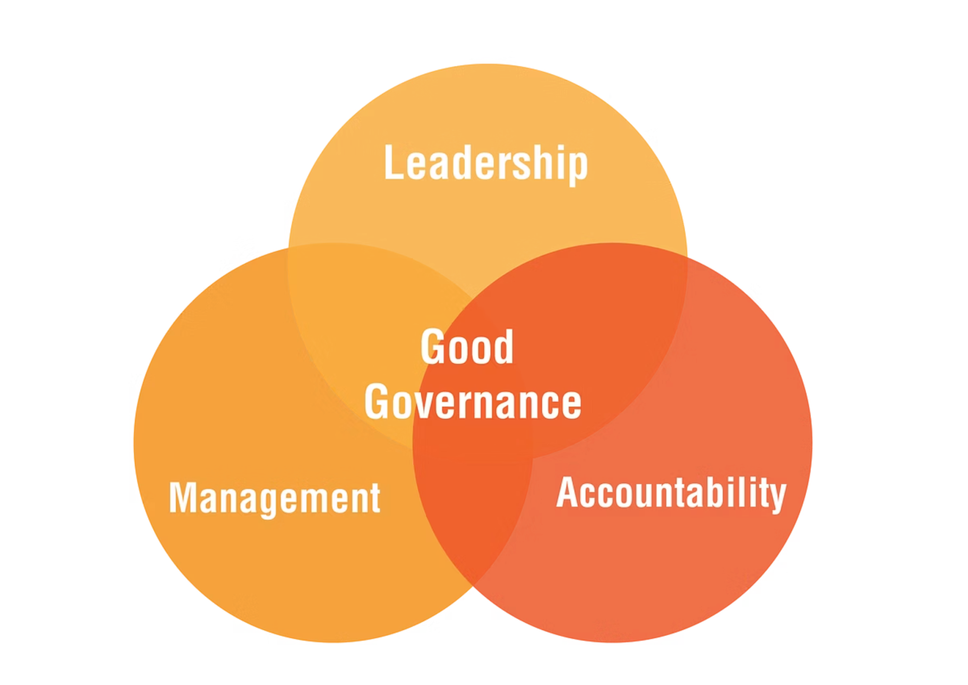
Strategic Examples – Governance, Investment, and Policy Alignment
Strategic resilience goals translate into concrete governance structures, investment decisions, and policy frameworks. These examples demonstrate how executive leadership creates the organizational conditions for effective resilience and recovery capabilities across all business functions.
Board-level risk committee oversight of resilience programs
Annual resilience investment budgets aligned with business strategy
Executive accountability frameworks for continuity performance
Strategic partnerships and vendor relationships supporting resilience goals
Regulatory compliance strategies that exceed minimum requirements
Notes:
Strong governance ensures accountability.
Investments reflect resilience importance.
Policies create consistency across the business.
Strategic partnerships prepare the organization for disruptions.
Example: A global retailer signs long-term contracts with backup logistics partners to maintain supply during natural disasters.

Slide 31
Tactical Goals – Translating Strategy into Programs
Tactical goals bridge the gap between strategic vision and operational execution. These goals focus on program development, resource coordination, and capability building across organizational boundaries. Tactical planning ensures that strategic resilience commitments become actionable initiatives with measurable outcomes.
1
2
Program Design and Architecture
Cross-Functional Coordination
Develop comprehensive resilience programs that align with strategic goals and integrate across business functions, technology systems, and operational processes.
Establish coordination mechanisms between IT, business units, risk management, and operations to ensure unified approach to resilience and recovery planning.
3
4
Capability Development
Performance Measurement
Build organizational capabilities across the four resilience layers: technology, people, processes, and vendor relationships through targeted investments and initiatives.
Implement metrics and monitoring systems that track resilience maturity, recovery capabilities, and program effectiveness against strategic objectives.
Notes:
Tactical teams turn strategy into executable programs.
They coordinate across business units and technologies.
They build the structures that support resilience—training, architecture, processes, vendors.
Example: A hospital’s IT, security, nursing, and facilities teams meet monthly to align all emergency readiness procedures

Slide 32

Tactical Examples – Cross-Functional Planning and Prioritization
Tactical resilience goals manifest through structured programs that coordinate activities across organizational boundaries. These examples show how tactical planning transforms strategic intent into coordinated action plans with clear accountability and measurable outcomes.
Business impact analysis programs involving all critical business functions
Cross-departmental recovery strategy development and validation
Technology resilience architecture projects spanning infrastructure and applications
Vendor risk management programs with integrated resilience requirements
Training and awareness programs reaching all employee levels
Testing and exercise programs validating capabilities across organizational layers
Notes:
Business impact analyses involve multiple departments.
Cross-functional recovery plans create unified response.
Resilience projects span infrastructure, applications, and vendor evaluations.
Employee training supports consistency.
Example: A bank runs a simulation where finance, IT, legal, and customer service all practice responding to a cyberattack together.

Slide 33



Operational Goals – Daily Execution and Response
Operational goals focus on day-to-day activities that maintain resilience capabilities and execute recovery procedures when needed. These goals ensure that strategic vision and tactical planning translate into effective action during normal operations and crisis situations. Operational excellence determines whether resilience programs succeed when tested.
Continuous Monitoring
Incident Response
Capability Maintenance
Real-time system health and performance monitoring
Rapid incident detection and classification
Regular backup validation and testing
Threat detection and security event analysis
Coordinated response team activation
Skills training and competency development
Business process performance tracking
Recovery procedure execution
Documentation updates and procedure validation
Stakeholder communication management
Vendor service level monitoring
Technology refresh and upgrade management
Notes:
Operational teams monitor systems in real time.
They respond immediately to disruptions.
They maintain backups, update documentation, and keep skills fresh.
Example: A SOC analyst notices suspicious login attempts and takes action, preventing a real breach through quick detection and response.

Slide 34
Operational Examples – Monitoring, Testing, and Adaptation
Operational resilience goals are achieved through consistent daily activities that maintain organizational readiness. These examples demonstrate how operational teams execute the procedures and processes that turn resilience planning into resilience capability, ensuring continuous preparedness and rapid response when disruptions occur.
24/7 security operations center monitoring for threats and incidents
Weekly backup validation procedures with documented recovery testing
Monthly tabletop exercises testing response procedures and decision-making
Quarterly business continuity plan updates based on organizational changes
Real-time performance dashboards tracking key resilience metrics
Continuous improvement processes incorporating lessons learned from incidents
Notes:
Nonstop monitoring catches issues early.
Regular tests validate capabilities.
Monthly drills keep teams ready.
Dashboards help track resilience metrics.
Example: An airline operational team performs daily aircraft checks to catch issues before flights begin.

Slide 35

Summary and Key Takeaways
Strategic, tactical, and operational goals create a comprehensive framework for organizational resilience and recovery. Success requires coordination across all three levels, with clear communication loops and feedback mechanisms ensuring continuous alignment and improvement.
Strategic goals provide executive vision and resource commitment for enterprise resilience
Tactical goals translate strategic vision into coordinated programs with measurable outcomes
Operational goals ensure daily execution maintains capabilities and delivers effective response
Cross-level coordination through feedback loops enables continuous improvement and adaptation
Balanced investment across all three levels maximizes organizational resilience and recovery capability
Resilience succeeds when strategic intent, tactical planning, and operational action work in sync
Notes:
Strategic vision drives direction.
Tactical planning turns vision into programs.
Operational teams execute and maintain readiness.
Feedback loops ensure ongoing improvement.
Strong coordination makes resilience effective.
Example: Think of a restaurant: owner sets standards, manager creates the schedule and processes, staff runs the kitchen daily. If all three communicate well, service stays consistent even during busy nights.

Slide 36
BREAK TIME
Be back in 15 mins.
Notes:
https://www.ncsc.gov.uk/static-assets/documents/PwnedPasswordsTop100k.txt

Slide 37
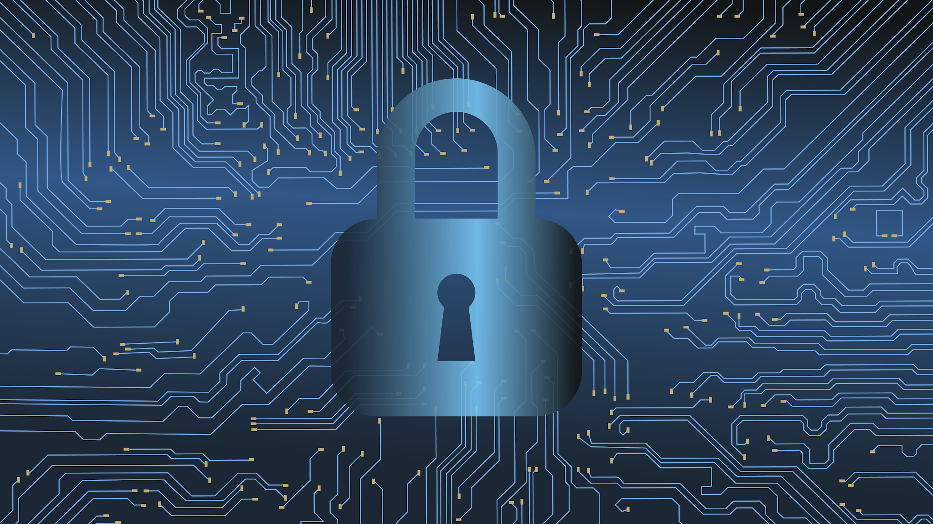
Understanding Dependencies and Enablers
Dependencies represent the critical relationships and resources your organization relies upon to function—potential single points of failure that can cascade into operational disruption. Enablers are the capabilities, controls, and resources that strengthen your organization's ability to maintain operations and recover quickly from incidents.
Learn to identify and map critical organizational dependencies across technology, people, processes, and vendors
Understand how enablers create redundancy and strengthen resilience capabilities
Master techniques for balancing dependency risks with enabling capabilities
Apply dependency mapping concepts to business impact analysis and continuity planning
1
Notes:
Dependencies are things your organization relies on to function. If they fail, operations stall.
Enablers are the things that strengthen continuity, reduce risk, and help recover quickly.
Strong resilience means mapping both and balancing them.
Example: Your phone depends on the battery. That’s a dependency. A portable power bank is an enabler. If your battery dies, the power bank keeps your phone running.

Slide 38
CLASS AGENDA
CLASS OBJECTIVES
Introduction to dependencies and enablers
Why dependencies matter for resilience
Identifying critical dependencies
Understanding resilience enablers
Balancing risk and capability
Define dependencies and enablers in business continuity context
Identify dependencies across technology, people, and processes
Explain how enablers strengthen continuity and recovery
Map and manage dependencies for organizational resilience

Slide 39

What are dependencies?
Dependencies are the critical resources, relationships, or capabilities that an organization relies upon to deliver its essential functions and services. These include functions, processes, and interdependencies that create the greatest impact when unavailable, affecting the entity's services and affected parties.
Technology infrastructure and systems required for operations
Key personnel and their specialized knowledge or skills
Critical processes that enable business function delivery
Third-party vendors and service providers essential to operations
Physical facilities, utilities, and environmental conditions
Data flows and information exchanges between systems and departments
Notes:
Dependencies include systems, key staff, processes, vendors, facilities, and data flows.
Losing a dependency disrupts service delivery and impacts internal and external parties.
You need visibility into every dependency to avoid blind spots.
Example: A restaurant depends on a working refrigerator. If it breaks, food spoils and business stops. That single dependency affects every customer.

Slide 40
Why Dependencies Matter for Resilience
Understanding dependencies is fundamental to building organizational resilience because they represent potential single points of failure that can cascade into broader operational disruption. Organizations face complex interdependencies that increase vulnerability, requiring coordinated frameworks for building organizational resilience.
Cascade Risk
Recovery Complexity
Resource Planning
Single dependency failure can trigger multiple system impacts
Dependencies determine restoration sequence and priorities
Accurate dependency mapping guides investment priorities
Interconnected operations create domino effects
Missing dependency mapping extends recovery timeframes
Critical dependencies warrant enhanced protection measures
Unidentified dependencies become critical vulnerabilities during incidents
Interdependent systems require coordinated recovery approaches
Dependency redundancy reduces single points of failure
Notes:
A failure in one place can trigger a chain reaction across the business.
Recovery becomes harder when dependencies are not mapped correctly.
Good mapping ensures better planning, investment, and prioritization.
Example: If a mall loses electricity, escalators stop, stores close, and payment systems go down. One dependency failure affects everyone quickly.

Slide 41




Common Dependency Categories
Comprehensive dependency analysis examines four primary organizational layers where critical interdependencies exist. Each category presents unique characteristics and risks that must be evaluated and managed systematically.
Technology Dependencies
People Dependencies
Core application systems and databases
Key subject matter experts and specialists
Network infrastructure and connectivity
Leadership and decision-making authority
Cloud services and hosting platforms
Customer-facing service representatives
Integration APIs and data feeds
Technical support and maintenance staff
Security controls and monitoring systems
External consultants and contractors
Process Dependencies
Vendor Dependencies
Critical business workflows and procedures
Software licensing and support agreements
Regulatory compliance requirements
Utility providers and telecommunications
Quality assurance and approval processes
Logistics and supply chain partners
Financial transactions and payment processing
Professional services and outsourced functions
Communication and escalation protocols
Regulatory bodies and certification authorities
Notes:
Technology, people, processes, and vendors form the four main dependency layers.
Each category brings different risks and needs different controls.
Ignoring any category creates instability.
Example: If only one employee knows how to operate a critical machine and they’re unavailable, production halts. That’s a people dependency.

Slide 42





Identifying and Mapping Critical Dependencies
Systematic dependency identification requires structured analysis combining business impact assessment with operational workflow mapping. This analysis identifies and prioritizes functions, processes, and dependencies to determine greatest impact, supporting incident understanding and response capabilities.
Inventory Assets
Catalog systems, processes, and resources
Map Relationships
Document interdependencies and data flows
Assess Criticality
Evaluate impact of dependency failure
Prioritize Focus
Rank dependencies by business risk
Notes:
Start by listing all assets and relationships.
Map how systems and processes connect to each other.
Evaluate impact levels and rank dependencies based on risk.
Example: Think of planning a family trip. You map who drives, who packs, who buys food, and what route you’ll take. If one piece fails, the whole trip gets delayed.

Slide 43




Understanding Enablers in Resilience
Enablers are the capabilities, controls, and resources that strengthen an organization's ability to anticipate, prepare for, respond to, and recover from disruptions. Unlike dependencies which create risk, enablers create strength and redundancy throughout organizational systems.
Redundancy and Backup
Training and Knowledge
Multiple pathways for critical functions including alternate systems, backup personnel, and secondary facilities that ensure continuity when primary capabilities are compromised.
Cross-training programs, documented procedures, and knowledge management systems that prevent single points of failure in human capabilities and institutional knowledge.
Communication Systems
Monitoring and Detection
Robust communication infrastructure and protocols that maintain coordination during incidents, including emergency notification systems and stakeholder communication plans.
Early warning systems and continuous monitoring capabilities that provide advance notice of potential disruptions, enabling proactive response before full impact occurs.
Notes:
Enablers strengthen your ability to prepare, respond, and recover.
Redundancy, training, communication, and monitoring give you options when primary capabilities fail.
Enablers reduce downtime.
Example: A school has two Wi-Fi routers. If one fails, the other keeps classes running. That redundancy is an enabler.

Slide 44
Examples of Effective Enablers
Successful enablers demonstrate measurable improvement in organizational resilience capabilities. These examples illustrate how different types of enablers strengthen specific aspects of continuity and recovery planning.
Geographic Redundancy
Cross-Functional Training
Automated Response
Enabler: Multi-site data replication with automatic failover capabilities between primary and secondary data centers located in different geographic regions.
Enabler: Comprehensive skills development programs ensuring multiple employees can perform critical roles across different departments and functions.
Enabler: Intelligent monitoring systems with automated incident response capabilities that can isolate threats and initiate recovery procedures without human intervention.
Benefit: Eliminates single points of failure for critical systems. Regional disasters cannot disrupt operations due to real-time data synchronization and seamless failover processes.
Benefit: Reduces dependency on individual specialists. Team members can assume essential responsibilities during absences, maintaining operational capability during workforce disruptions.
Benefit: Accelerates response time from hours to minutes. Automated containment limits incident scope while human responders develop comprehensive mitigation strategies.
Notes:
Geographic redundancy prevents regional disruptions from taking systems offline.
Cross-training ensures operations don’t depend on one person.
Automated response tools speed up detection and containment.
Example: Online banking uses real-time replication to mirror data across regions. If one data center fails, customers still access their accounts instantly.

Slide 45

Balancing Dependencies and Enablers
Effective resilience requires strategic balance between managing dependency risks and building enabling capabilities. Organizations must systematically evaluate where dependencies create unacceptable risk and where enablers provide cost-effective protection.
Managing Dependency Risk
Building Enabling Capabilities
Identify Critical Dependencies
Create Redundancy
Map all essential relationships and single points of failure.
Develop alternate pathways for critical functions.
Assess Impact Levels
Enhance Monitoring
Quantify business disruption from dependency failures.
Implement early warning and detection systems.
Reduce Where Possible
Strengthen Response
Eliminate unnecessary dependencies through redesign.
Build rapid response and recovery capabilities.
Key Principle: The goal is not to eliminate all dependencies—some are essential for efficient operations. Instead, focus on ensuring that critical dependencies have corresponding enablers that provide alternate pathways or enhanced resilience.
Notes:
The goal isn’t to remove every dependency—it’s to reduce the risk of their failure.
Critical dependencies must have matching enablers.
Enablers provide backup paths, better detection, and faster response.
Example: A delivery company uses two GPS providers. If one service goes down, drivers switch to the second system and routes continue normally.

Slide 46

Summary and Key Takeaways
Dependencies expose risk through single points of failure that can cascade into broader operational disruption
Enablers create flexibility and redundancy that strengthen organizational resilience and recovery capabilities
Both dependencies and enablers must be reviewed and mapped regularly as part of comprehensive business impact analysis
Effective resilience balances dependency risk management with strategic enabler investments
Collaboration and communication systems serve as critical enablers that connect and coordinate all other capabilities
Understanding dependencies helps us identify weak links in our operational chain; building enablers ensures we can withstand disruption and recover quickly when incidents occur.
As you continue your DRI certification preparation, remember that dependency and enabler analysis forms the foundation for effective business impact analysis, strategy development, and recovery planning across all domains of the Professional Practices framework.
Notes:
Dependencies = risk points. Enablers = stabilizers.
Mapping both is essential for solid BIA and continuity planning.
Balance happens when each high-risk dependency has a strong backup capability.
Collaboration and communication tie everything together.
Example: A concert venue relies on lighting, sound systems, staff, and vendors. Backup generators, staff training, and communication radios act as enablers, keeping the event running even if something fails.

Slide 47
BREAK TIME
Be back in 15 mins.
Notes:
https://www.ncsc.gov.uk/static-assets/documents/PwnedPasswordsTop100k.txt

Slide 48

Operational Resilience Lifecycle
the operational resilience lifecycle is a continuous, systematic process that strengthens an organization's ability to withstand, adapt to, and recover from disruptions. This comprehensive approach ensures that critical business functions remain operational during adverse events while continuously improving organizational capabilities through structured phases of planning, implementation, testing, and refinement.
Understand each of the seven key phases of the resilience lifecycle
Learn how lifecycle phases integrate with business continuity frameworks
Recognize the importance of continuous testing and improvement
Apply lifecycle principles to real-world operational scenarios
1
Notes:
The lifecycle is not a one-time project. It’s an ongoing system that keeps the organization strong.
Each phase builds on the previous one and prepares for the next.
The goal is staying operational during disruptions, not scrambling afterward.
Example: Think of fitness training. You don’t train once and stop. You plan, practice, adjust, and repeat to stay strong year-round.

Slide 49
CLASS AGENDA
CLASS OBJECTIVES
Introduction to the resilience lifecycle
The seven key phases
Practical applications and examples
Integration with business continuity
Lifecycle optimization and review
Define each phase of the operational resilience lifecycle
Explain the relationship between planning, testing, and improvement
Identify how lifecycle management supports business continuity
Recognize maturity elements for ongoing monitoring and review

Slide 50

Overview of the Operational Resilience Lifecycle
The lifecycle represents a systematic approach to building and maintaining organizational resilience through continuous phases. Unlike linear models, this framework emphasizes ongoing improvement and adaptation.
Seven interconnected phases working in continuous cycle
Proactive approach to resilience building and maintenance
Integration points with existing business processes
Feedback loops enabling continuous improvement
Alignment with regulatory and industry frameworks
Scalable approach for organizations of all sizes
Notes:
There are seven phases, and they form a continuous loop.
This model integrates with everyday business activity, not just emergencies.
Feedback from each cycle improves the next cycle.
Example: Like running a restaurant: you plan menus, order supplies, cook, collect feedback, and improve the next week’s menu and processes.

Slide 51

Why a Lifecycle Approach Matters
Traditional one-time planning approaches fail in today's dynamic threat landscape. The lifecycle approach ensures resilience capabilities evolve with changing risks and business requirements.
Addresses rapidly evolving cyber and operational threats
Provides structure for continuous improvement efforts
Ensures consistent approach across organizational units
Creates accountability for resilience maintenance
Supports regulatory compliance and audit requirements
Enables proactive rather than reactive resilience building
Notes:
Threats evolve constantly, so static plans go outdated fast.
A lifecycle keeps resilience fresh, relevant, and tested.
Accountability increases because roles are defined in every phase.
Example: Software updates: if you never update your apps, bugs and vulnerabilities pile up. Regular updates keep the system safe.

Slide 52

Phase 1: Planning
The planning phase establishes the foundation for organizational resilience by defining scope, objectives, and governance structures. This phase sets the strategic direction for all subsequent lifecycle activities.
Define resilience program scope and boundaries
Establish governance structure and accountabilities
Set resilience objectives aligned with business strategy
Identify regulatory and compliance requirements
Allocate resources and establish budgets
Create project timelines and milestones
Notes:
You set the scope, goals, and responsibilities.
You decide what matters most for resilience and allocate resources.
This phase creates the foundation for everything else.
Example: Before opening a new gym, you create budget plans, equipment lists, safety rules, and staffing needs.

Slide 53

Phase 2: Impact Assessment
Impact assessment identifies critical business processes, dependencies, and potential consequences of disruptions. This analysis drives prioritization and resource allocation decisions throughout the lifecycle.
Conduct comprehensive business impact analysis
Identify critical processes and supporting systems
Map dependencies and single points of failure
Establish recovery time and point objectives
Assess financial and operational consequences
Prioritize processes based on criticality and impact
Notes:
You analyze what’s critical and what the impact would be if those things fail.
This phase identifies dependencies, risks, and consequences.
It also defines acceptable downtime and data loss levels.
Example: If you run a café, losing your espresso machine impacts sales more than losing your smoothie blender. You prioritize based on impact.

Slide 54

Phase 3: Strategy
The strategy phase develops specific approaches and solutions to address identified risks and vulnerabilities. Strategies must align with business objectives and risk tolerance levels.
Develop risk treatment strategies for identified threats
Design recovery and continuity solutions
Evaluate technology and process alternatives
Consider cost-benefit analysis for strategy options
Align strategies with organizational risk appetite
Create integration plans with existing capabilities
Notes:
Here you decide how to handle the risks discovered in assessment.
You design solutions that match business priorities.
You evaluate cost versus benefit and pick the best option.
Example: If you live in a flood zone, choosing between sandbags, raising your house foundation, or flood insurance reflects strategy decisions.

Slide 55
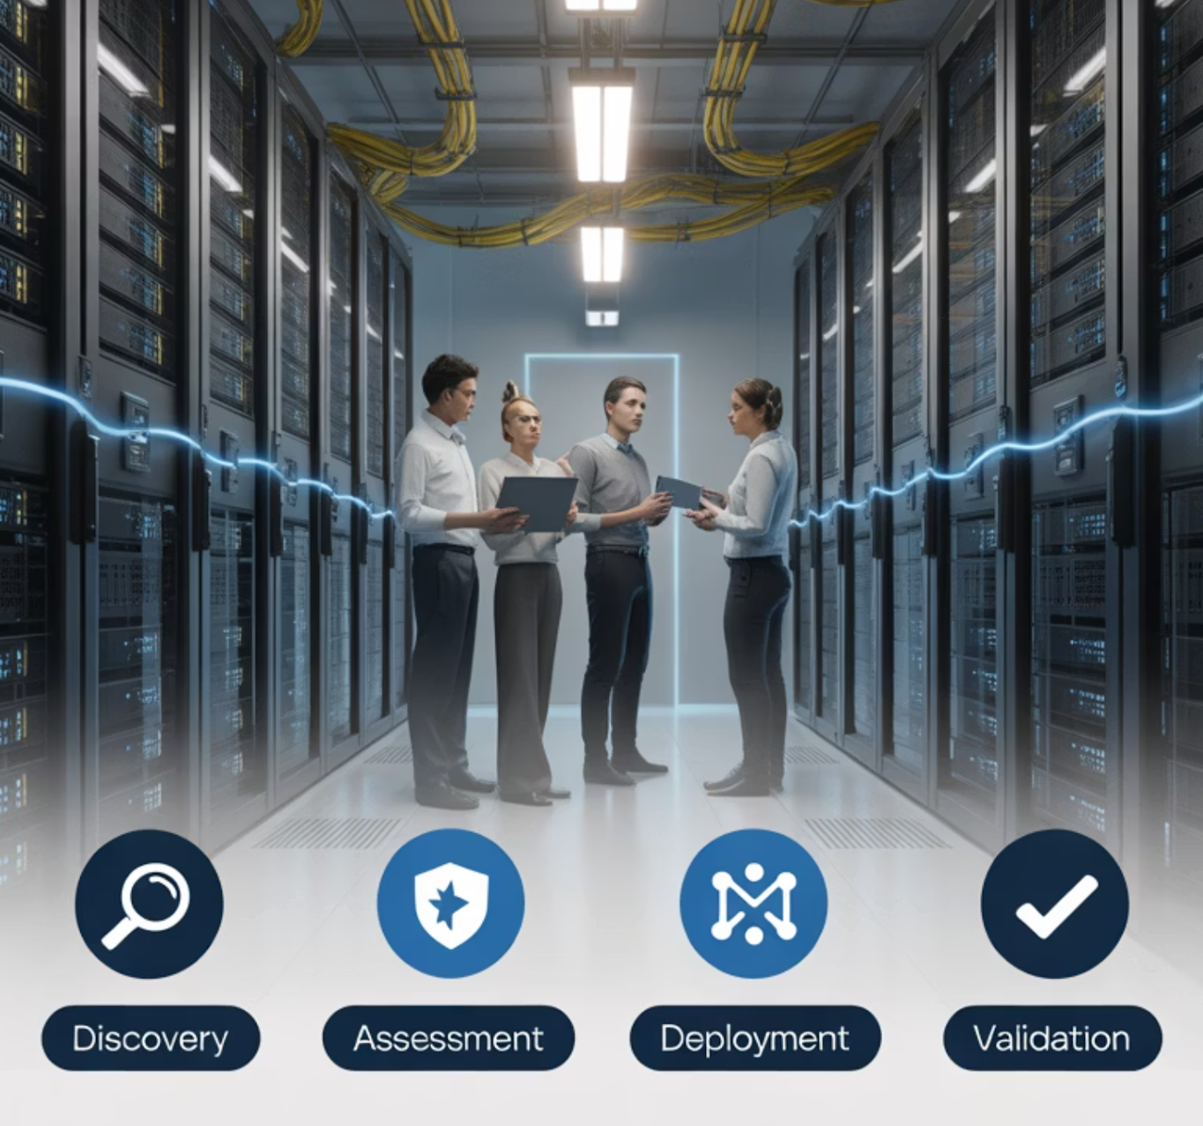
Phase 4: Implementation
Implementation transforms strategic plans into operational capabilities through systematic deployment of solutions. This phase requires careful coordination and change management to ensure successful adoption.
Deploy technology infrastructure and backup systems
Implement new processes and procedures
Train personnel on new capabilities and responsibilities
Establish communication and escalation protocols
Create documentation and operational guides
Manage change across affected business units
Notes:
You put the strategies into action—deploy systems, document procedures, train teams.
This phase often requires cross-department coordination.
Implementation introduces new responsibilities and workflows.
Example: Installing home smoke detectors is strategy; teaching your family how to use them and practicing fire drills is implementation.

Slide 56

Phase 5: Testing
Testing validates the effectiveness of implemented resilience capabilities through structured exercises and simulations. Define the exercise/testing criteria to validate that the plans will accomplish the desired goal.
Conduct tabletop exercises for decision-making validation
Perform functional tests of recovery procedures
Execute full-scale simulation exercises
Test communication and notification systems
Document test results and identify improvement areas
Validate backup and recovery capabilities
Notes:
You validate whether the plans actually work under pressure.
Different test types check leadership decisions, technology, and communication.
Test findings drive improvements.
Example: Fire drills in schools help reveal bottlenecks or confusion so the school can adjust routes and instructions.

Slide 57

Phase 6: Monitoring
Continuous monitoring ensures resilience capabilities remain effective and identifies emerging risks or changes requiring attention. This phase provides early warning of potential issues.
Establish key performance indicators for resilience
Implement continuous monitoring systems
Track threat landscape changes and emerging risks
Monitor system performance and availability
Assess compliance with regulatory requirements
Generate regular reporting for management oversight
Notes:
You watch for emerging risks and performance issues.
Continuous monitoring ensures systems stay healthy.
You track indicators, threats, and compliance in real time.
Example: Modern cars constantly monitor engine health. Warning lights alert you before a problem becomes dangerous.

Slide 58

Phase 7: Review
Regular review evaluates overall program effectiveness and identifies opportunities for enhancement. This phase closes the lifecycle loop by feeding insights back into planning activities.
Conduct periodic program maturity assessments
Review test results and lessons learned
Analyze incident response performance
Evaluate changes in business or threat environment
Update strategies based on new requirements
Plan improvements for next lifecycle iteration
Notes:
You evaluate overall program effectiveness by studying incidents and test results.
You update strategies based on new risks or changes in the business.
Review closes the loop and feeds back into planning.
Example: Athletes review footage of their performance after games, identify weaknesses, and adjust training plans.

Slide 59












How the Phases Interconnect
The lifecycle phases operate as an integrated system where outputs from one phase become inputs to others. Understanding these interconnections ensures effective program coordination.
Assess
Plan
Identifies critical needs
Sets direction and scope
Monitor
Strategize
Tracks performance
Designs solutions
Test
Implement
Validates effectiveness
Deploys capabilities
Each phase provides feedback to others, creating multiple improvement loops that strengthen overall resilience capabilities over time.
Notes:
Outputs from one phase become inputs to another.
The lifecycle creates multiple feedback loops, not a simple linear flow.
Integration ensures resilience evolves naturally with business operations.
Example: Cooking a meal: plan ingredients, taste during cooking (monitoring), adjust seasoning (strategy), serve, and after eating review what to improve next time.

Slide 60
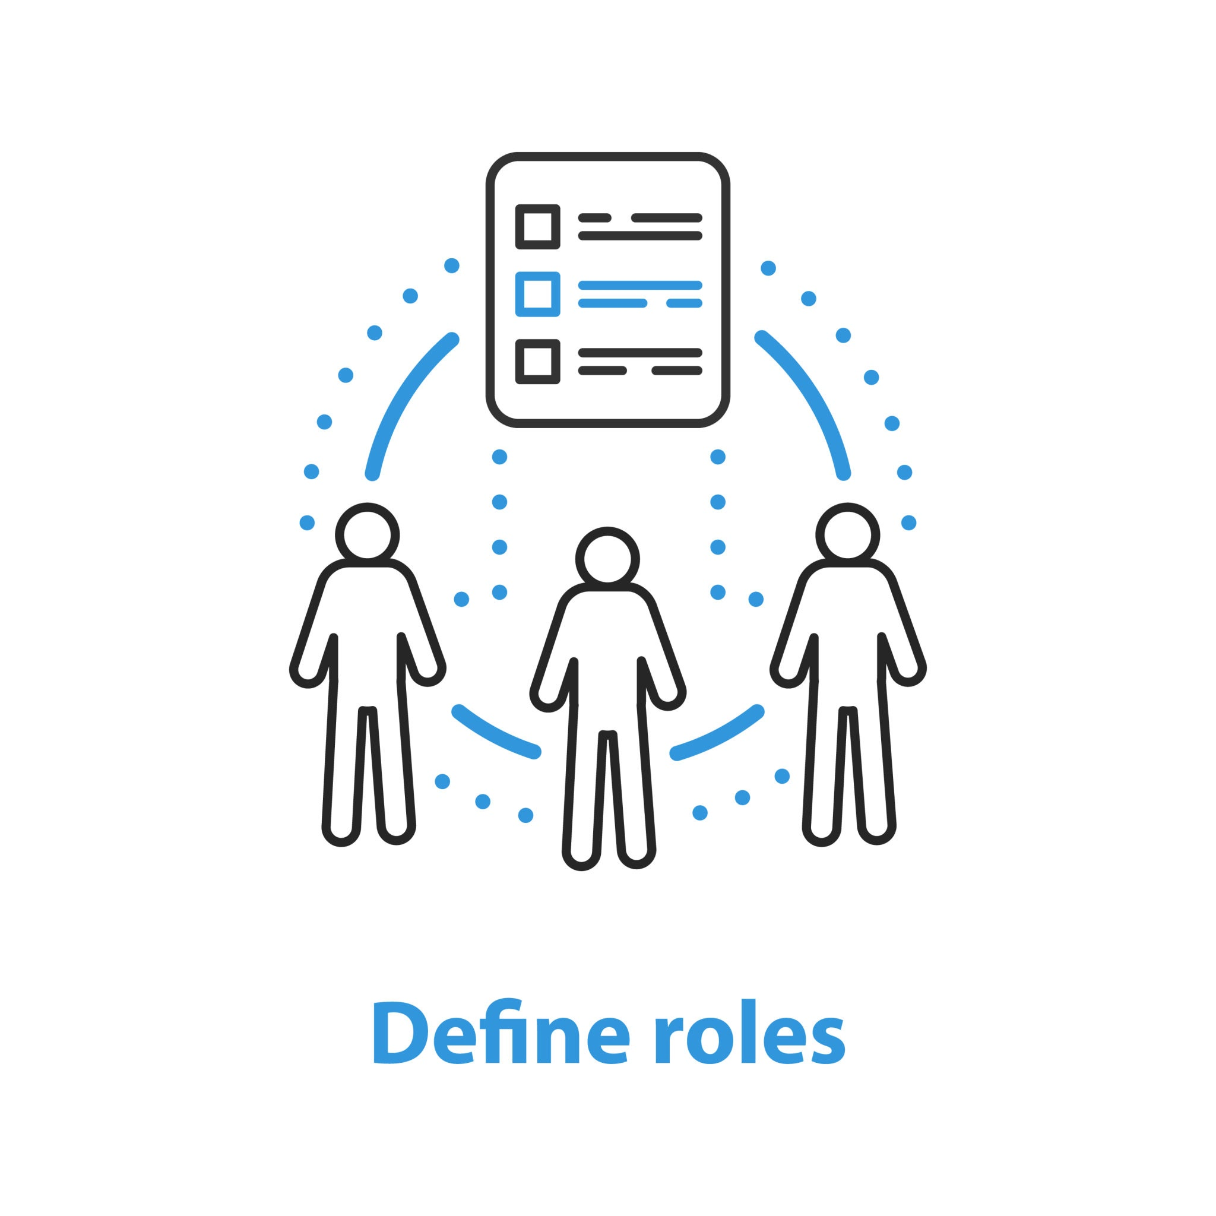
Roles and Responsibilities
Successful lifecycle implementation requires clear accountability across organizational levels. Each stakeholder group has specific responsibilities within the resilience framework.
Executive leadership provides strategic direction and resources
Risk managers coordinate threat assessment and mitigation
IT professionals implement technical resilience solutions
Business unit leaders ensure operational continuity planning
Compliance teams manage regulatory alignment
All employees participate in training and exercises
Notes:
Leadership sets direction, risk expectations, and resources.
Risk teams analyze threats and coordinate mitigation plans.
IT, business units, compliance, and all staff share responsibility for resilience.
Example: In a school emergency: principal leads, teachers direct students, security manages access, and staff follow the plan together.

Slide 61
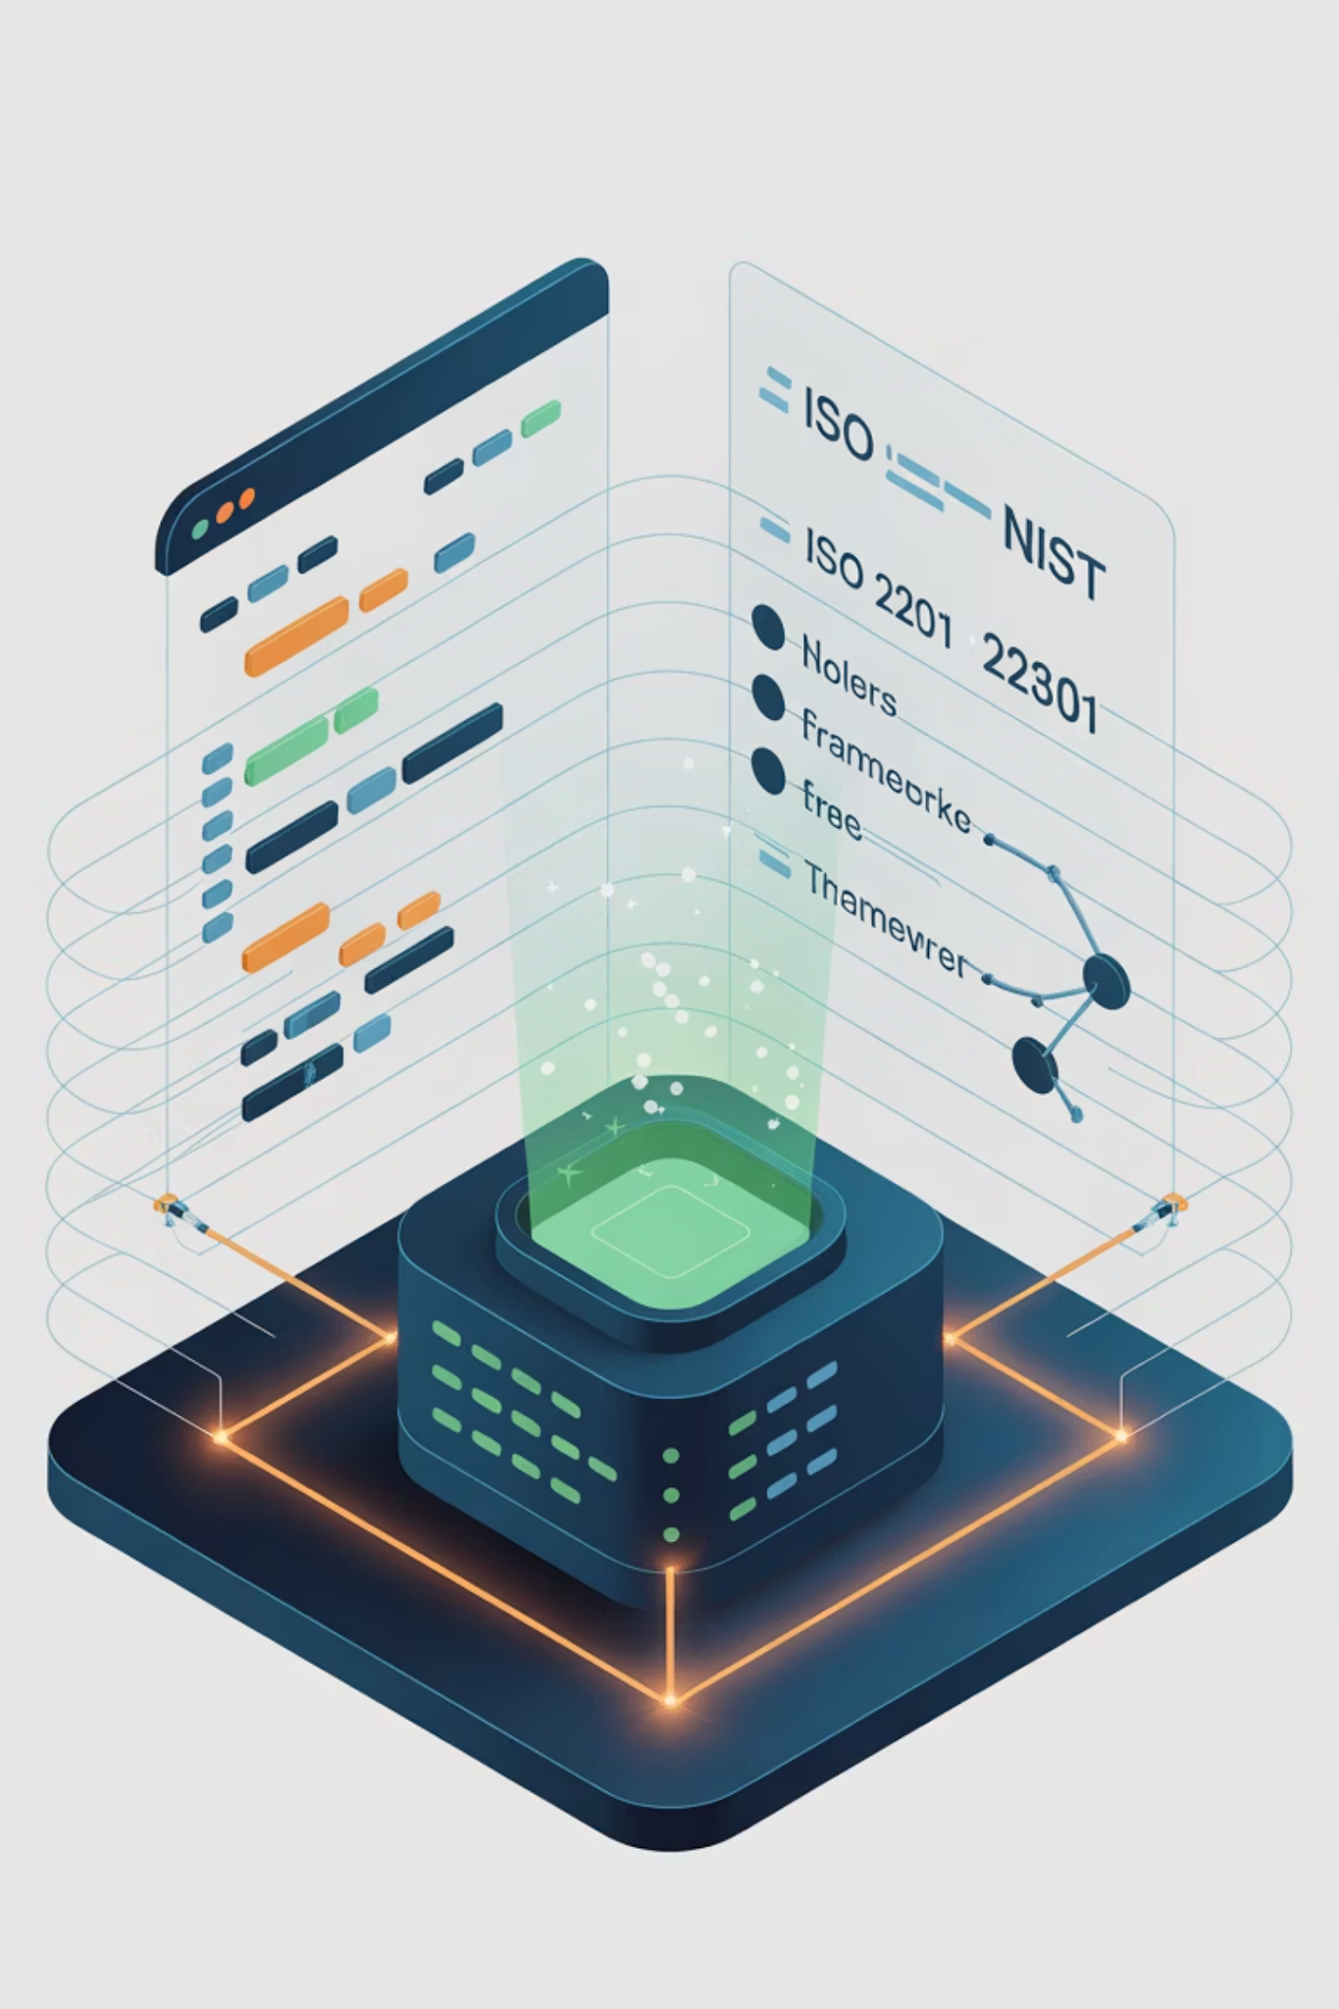
Tools and Frameworks (ISO 22301, NIST SP 800-34)
Industry standards provide proven methodologies for lifecycle implementation. Compliance and Standards: Includes knowledge of regulatory requirements and standards such as ISO 22301, NFPA 1600.
ISO 22301 provides business continuity management framework
NIST SP 800-34 guides IT disaster recovery planning
NFPA 1600 addresses emergency and disaster management
COSO framework supports risk management integration
Industry-specific guidelines address sector requirements
Integration approaches combine multiple frameworks effectively
Notes:
Standards like ISO 22301 and NIST SP 800-34 guide the structure of resilience programs.
These frameworks ensure consistency and audit readiness.
Industry guidelines support integration.
Example: Using a recipe book makes cooking standardized and repeatable; industry frameworks do the same for resilience.

Slide 62
Integrating Lifecycle with Business Continuity
The resilience lifecycle complements traditional business continuity planning by providing systematic approach to capability development and maintenance. Integration ensures unified organizational preparedness.
Align lifecycle phases with BCM program activities
Integrate impact assessment with BIA processes
Connect strategy development with BCM planning
Coordinate testing across resilience and continuity
Share monitoring data between programs
Create unified governance and reporting structures
Notes:
The lifecycle strengthens traditional continuity programs by filling gaps and adding structure.
Joint planning ensures both resilience and recovery align with each other.
Data from one program supports decision-making in the other.
Example: A sports team reviews practice performance and game performance together to build a complete improvement plan.

Slide 63

Example: Applying Lifecycle to a Critical IT System
This example demonstrates lifecycle application to a customer-facing e-commerce platform, showing how each phase contributes to overall system resilience.
Planning: Define RTO of 4 hours for customer transactions
Assessment: Identify database as single point of failure
Strategy: Implement geographic database replication
Implementation: Deploy secondary data center with failover
Testing: Conduct quarterly failover exercises
Monitoring: Track replication lag and system health
Notes:
Lifecycle steps applied to a real system show how resilience becomes practical.
The database dependency is the most critical point.
Testing failover ensures real-world readiness.
Example: If an online store mirrors its database across two regions and practices failover quarterly, customers never notice downtime.

Slide 64
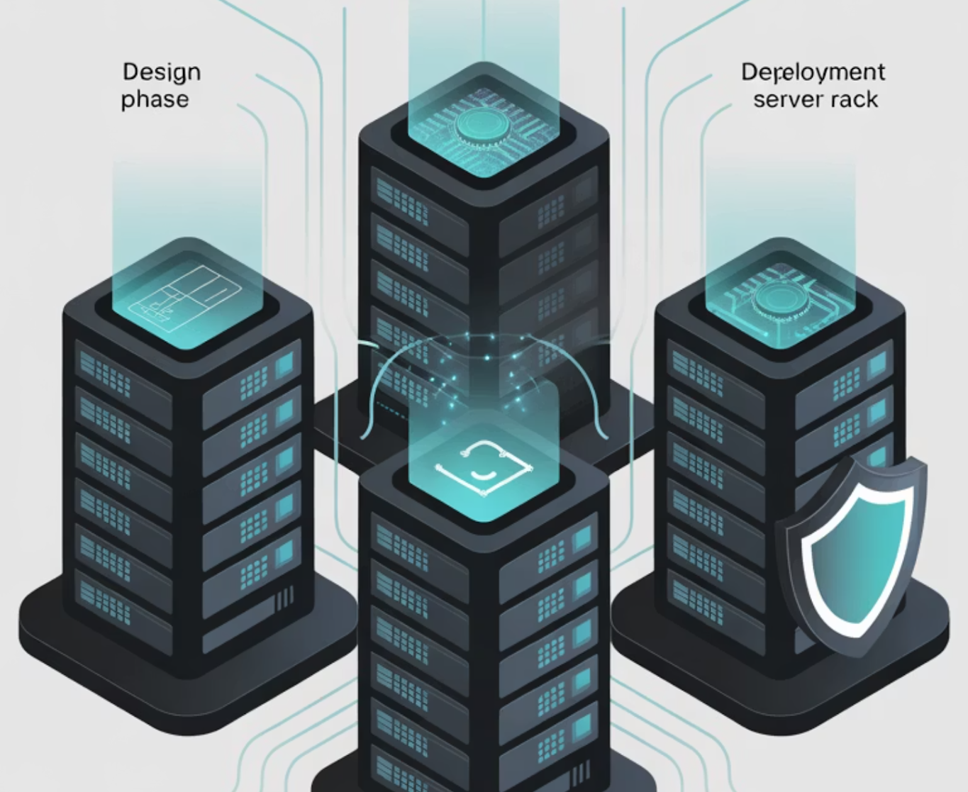
Example: Lifecycle in Cloud Environments
Cloud environments require adapted lifecycle approaches that address shared responsibility models and dynamic infrastructure. This example shows lifecycle application to hybrid cloud architecture.
Planning: Define cloud and on-premise responsibilities
Assessment: Analyze multi-cloud dependencies and risks
Strategy: Design cross-cloud redundancy and backup
Implementation: Deploy automated scaling and recovery
Testing: Validate cross-provider failover capabilities
Monitoring: Track service levels across all providers
Notes:
Cloud resilience requires shared responsibility understanding.
Cross-cloud redundancy protects against provider outages.
Monitoring multiple providers ensures service continuity.
Example: Streaming platforms store shows on multiple cloud providers. If one cloud fails, the platform keeps streaming through another.

Slide 65
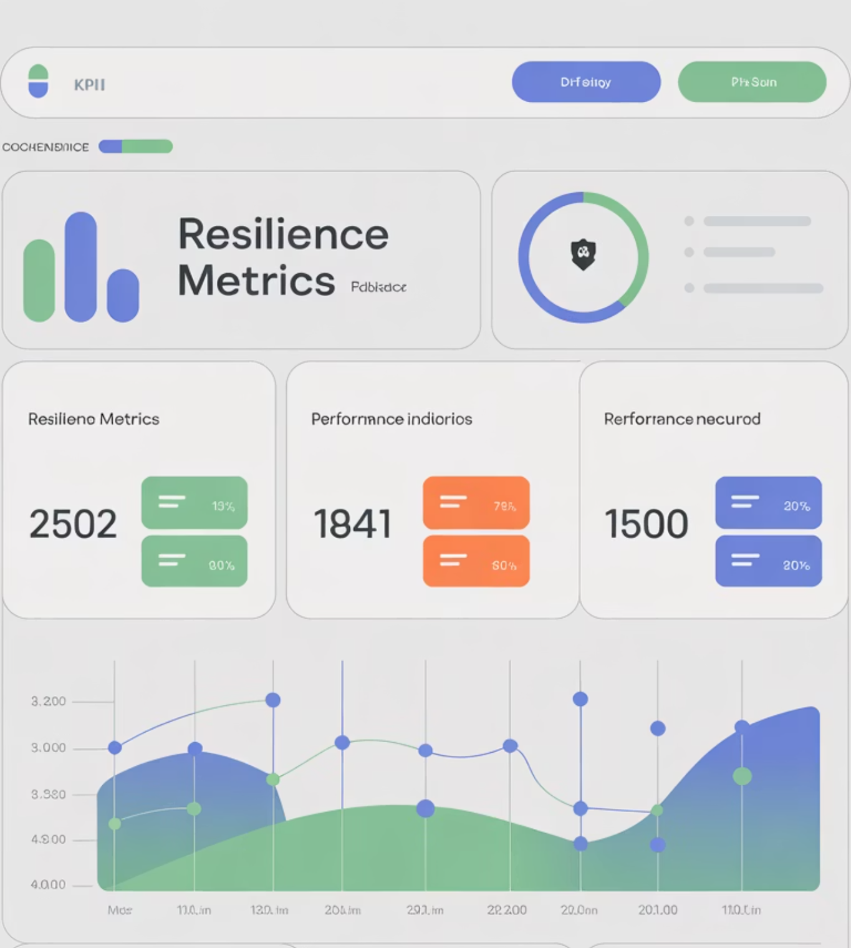
Measuring Lifecycle Effectiveness (KPIs)
Key performance indicators provide objective measures of lifecycle maturity and effectiveness. Metrics should address both process efficiency and outcome achievement.
Time to recovery during actual incidents
Percentage of critical processes with tested plans
Frequency and quality of lifecycle phase execution
Cost-effectiveness of resilience investments
Stakeholder satisfaction with program performance
Compliance with regulatory and audit requirements
Notes:
KPIs show where the lifecycle is strong and where improvements are needed.
Metrics track recovery time, testing frequency, cost efficiency, and stakeholder satisfaction.
Good KPIs prove resilience value to leadership.
Example: Fitness apps track your time, reps, consistency, and progress to show how effective your routine is.

Slide 66

Challenges in Maintaining Lifecycle Maturity
Organizations face common obstacles in sustaining effective lifecycle programs. Understanding these challenges enables proactive mitigation and continuous improvement.
Resource constraints limiting comprehensive implementation
Competing priorities reducing focus on resilience
Organizational changes affecting program continuity
Technology evolution requiring capability updates
Skills gaps in specialized resilience competencies
Measurement difficulties in demonstrating value
Notes:
Limited resources, shifting priorities, and skill gaps can weaken resilience.
Technology changes quickly, so programs must keep up.
Measuring ROI is difficult without strong metrics.
Example: A gym that stops maintaining equipment eventually ends up with broken machines—neglect makes resilience fail.

Slide 67

Governance and Leadership Oversight
Effective governance ensures lifecycle programs receive appropriate attention, resources, and strategic alignment. Leadership engagement drives organizational commitment to resilience.
Board-level oversight of resilience strategy and performance
Executive sponsorship for lifecycle program initiatives
Regular reporting on program maturity and effectiveness
Integration with enterprise risk management frameworks
Resource allocation decisions based on risk priorities
Cultural change management supporting resilience mindset
Notes:
Board engagement ensures resilience gets funding and attention.
Leadership shapes culture and keeps continuity aligned with business goals.
Integrated reporting keeps everything aligned.
Example: A company where executives participate in emergency drills signals seriousness—staff follow that example.

Slide 68
Linking Lifecycle Review to Certification Readiness
The lifecycle approach directly supports DRI International certification preparation by providing structured approach to resilience capability development. Understanding lifecycle concepts enhances exam readiness and professional competence.
ABCP Preparation
CBCP Preparation
Lifecycle planning and assessment phases support Associate-level understanding of business continuity fundamentals and impact analysis techniques.
All lifecycle phases align with Certified-level competencies in program development, implementation, and maintenance requirements.
Regular lifecycle execution provides practical experience with DRI framework concepts, making certification studies more meaningful and applicable to real-world scenarios.
Notes:
The lifecycle directly supports DRI certification requirements.
Different phases map to different certification domains.
Practicing lifecycle activities improves exam readiness.
Example: Studying music theory is easier when you already play an instrument—hands-on lifecycle work supports certification learning.

Slide 69
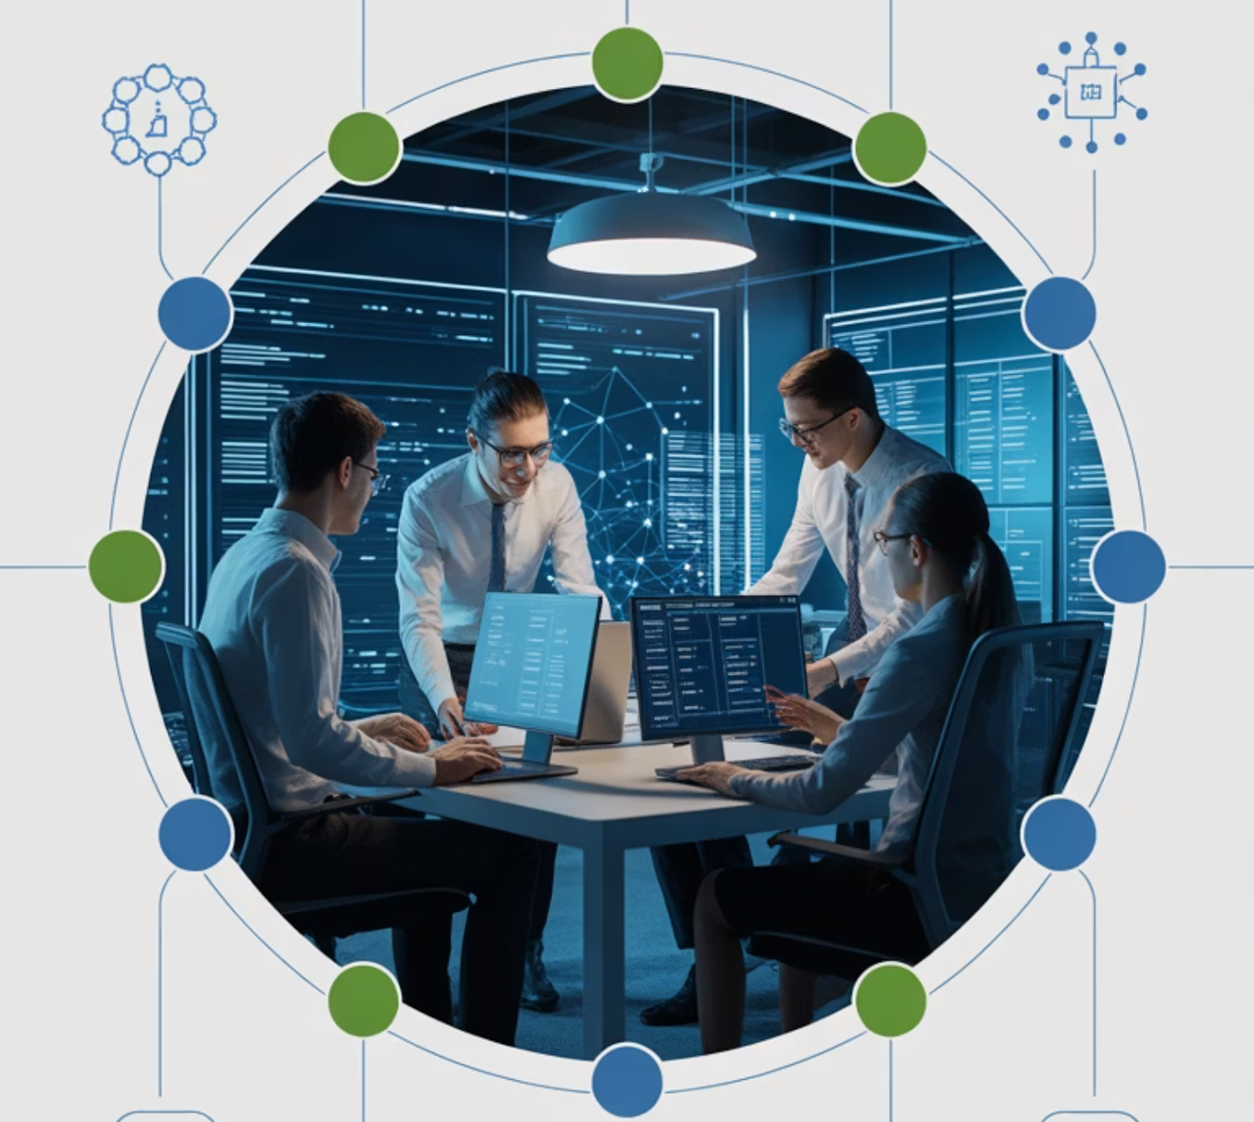
Summary and Key Takeaways
The lifecycle provides continuous preparedness through systematic phases
Each phase supports both proactive and reactive capabilities
Testing, monitoring, and review sustain long-term improvement
Team collaboration drives lifecycle success across all phases
Resilience is a continuous lifecycle of improvement, not a destination
The Operational Resilience Lifecycle transforms one-time planning into continuous capability development. By following this structured approach, organizations build sustainable resilience that adapts to changing threats and business requirements while supporting regulatory compliance and professional certification goals.
Notes:
Resilience maturity grows through iteration, not one-time planning.
Testing and monitoring are essential to maintaining strength.
Collaboration across all levels is required.
Continuous improvement keeps resilience aligned with real threats.
Example: Think of maintaining physical health: you don’t reach your goal once and stop—you adjust, measure progress, train consistently, and evolve over time.

Slide 70
BREAK TIME
Be back in 15 mins.
Notes:
https://www.ncsc.gov.uk/static-assets/documents/PwnedPasswordsTop100k.txt

Slide 71

Discussion & Recap: Core Concepts in Resilience and Recovery
Key resilience concepts aligned with DRI Professional Practices for BCM, supporting certification prep.
Resilience vs. recovery takeaways
Strategic, tactical, & operational DRI alignment
Certification dependencies & enablers
Operational resilience lifecycle mastery
1
Notes:
We’re reviewing the main pillars that support resilience thinking.
These concepts line up with what you need for DRI career paths.
This recap connects everything: resilience vs recovery, organizational levels, dependencies, enablers, and lifecycle.
Example: Think of learning to drive. You learn rules, practice skills, understand road risks, and apply everything together. All pieces matter.

Slide 72

Core Idea 1: Resilience vs Recovery
Resilience
Proactive strength-building
Absorb & adapt to change
Maintain critical functions
Focus: Prevention, adaptation
Recovery
Reactive restoration
Return to normal operations
Defined by RTO/RPO
Focus: Restoration, continuity
Notes:
Resilience focuses on avoiding disruption or reducing its impact.
Recovery focuses on restoring normal operations after disruption.
They answer two different questions: “How do we stay strong?” and “How do we bounce back?”
Example: Having a surge protector is resilience. Resetting your breaker after a power surge is recovery.

Slide 73
Core Idea 2: Strategic, Tactical & Operational Levels
Resilience and recovery operate at three levels:
Strategic
Operational
Tactical
Leadership & Governance
Daily Response
Program Coordination
Resource Allocation
Incident Management
Policy Development
Risk Tolerance
Continuous Improvement
Cross-unit Integration
Notes:
Leadership sets direction, risk appetite, and priorities.
Tactical teams build programs that translate strategy into real plans.
Operational teams execute those plans in daily work and during incidents.
Example: In firefighting: chiefs decide policies (strategic), captains plan response tactics (tactical), firefighters respond to emergencies (operational).

Slide 74

Core Idea 3: Dependencies & Enablers
Dependencies
Vulnerabilities & single points of failure
System interdependencies
Vendor reliance
Critical staffing
Infrastructure
Enablers
Redundancy, training, & monitoring
Alternate capabilities
Cross-training
Continuous Monitoring
Documentation
Notes:
Dependencies represent risks and reliance points that can break.
Enablers provide redundancy, support, and flexibility.
Both must be mapped together so gaps and strengths are visible.
Example: Your laptop depends on Wi-Fi (dependency). Your hotspot is the enabler that keeps you connected if Wi-Fi fails.

Slide 75
Core Idea 4: Operational Resilience Lifecycle
1
2
Planning
Impact Assessment
3
4
Strategy
Implementation
5
6
Testing
Monitoring
7
Review
Notes:
The lifecycle gives structure: plan, assess, strategize, implement, test, monitor, review.
Each phase prepares the organization for the next.
Continuous improvement keeps the organization ready for evolving threats.
Example: Learning martial arts: you learn techniques (plan), train weaknesses (assess), apply strategy (spar), test skills (compete), monitor progress, and review training.

Slide 76

Discussion Prompts
Organizational Application
How do resilience and recovery overlap? What are the biggest gaps?
Lifecycle Challenges
Which phase of the resilience lifecycle is hardest to maintain?
Dependency Management
How do critical dependencies affect recovery planning?
Certification Confidence
Which DRI domain are you most confident in? Which needs more focus?
Notes:
How do resilience and recovery intersect in your workplace?
Which lifecycle phase is hardest to maintain consistently?
Which dependency in your organization is most fragile?
Where are you strongest in the DRI domains, and where do you need more focus?
Example to spark thought: Ask: “If your main system crashed right now, which department would panic first? Why?” This helps people identify invisible dependencies.

Slide 77

Summary & Key Takeaways
Resilience vs. Recovery
Proactive strength vs. structured restoration.
Organizational Alignment
Strategy, tactics, and operations for continuity.
System Stability
Dependencies + enablers equal stability.
Continuous Improvement
7-phase lifecycle for ongoing progress.
Notes:
Resilience reduces impact; recovery restores operations.
Organizational alignment makes continuity stronger.
Dependencies create risk; enablers create stability.
The lifecycle ensures improvement is ongoing.
Example: Think of a hospital ER: it prepares for emergencies (resilience), treats patients after incidents (recovery), relies on equipment and staff (dependencies), and uses backup power and protocols (enablers).

Slide 78
Kahootz & Quiz Time
Notes:
https://www.ncsc.gov.uk/static-assets/documents/PwnedPasswordsTop100k.txt

